Slide 1
MARKET SEGMENTATION
PROJECT BY:
SOWNDARYA
ALANKRATH
VIGNESH
LOGESH
IHJAS

Slide 2
objective:
A case requires developing a customer segmentation to give recommendations like saving plans, loans, wealth management, etc. on target customer groups.

Slide 3
PROCESS DEFINITION
In marketing, market segmentation divides a broad consumer or business market, normally consisting of existing and potential customers, into sub-groups of consumers based on some type of shared characteristics.

Slide 4
About dataset
The sample Dataset summarizes the usage behavior of about 9000 active credit card holders during the last 6 months. The file is at a customer level with 18 behavioral variables.
fEATURES OR VARIABLES OF THE DATASET
CUSTOMER ID
BALANCE
BALANCE FREQUENCY
PURCHASES
ONE-OFF PURCHASES
INSTALLMENT PURCHASES
CASH ADVANCE
PURCHASES FREQUENCY
ONE-OFF PURCHASES FREQUENCY
INSTALLMENT PURCHASES FREQUENCY
CASH ADVANCE FREQUENCY
CASH ADVANCE TRX
PURCHASES TRX
CREDIT LIMIT
PAYMENTS
MINIMUM PAYMENTS
PRC FULL PAYMENT
TENURE
CLUSTER

Slide 5
Tools & Algorithms
TOOL
Python
ALGORITHM USED IN THE PROJECT
K – MEANS CLUSTERING
Python is the programming language which is used to code the project. Various algorithms used are coded in Python
K-Means Clustering is an Unsupervised Learning algorithm, which groups the unlabeled dataset into different clusters.

Slide 6
Project process
RESEARCH AND BUSINESS UNDERSTANDING
The first thing you have to do before you solve a problem is to define exactly what it is. You need to be able to translate data questions into something actionable.
DATA PRE-PROCESSING
Data preprocessing can refer to the manipulation or dropping of data before it is used in order to ensure or enhance performance, and is an important step in the data mining process.
EDA
Exploratory data analysis is an approach to analyzing data sets to summarize their main characteristics, often using statistical graphics and other data visualization methods.
MODEL BUILDING
Model building process where different machine learning algorithms are used to make different machine learning models for various applications.
MODEL DEPLOYMENT
Model Deployment is the process where various ML algorithms are deployed on various platforms like flask, streamlit, various other open-source Platforms, etc. Here we have used Streamlit to deploy our ML project.

Slide 7
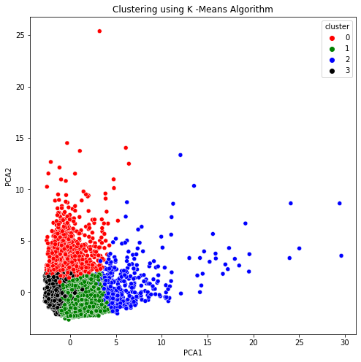
Cluster segments

Slide 8
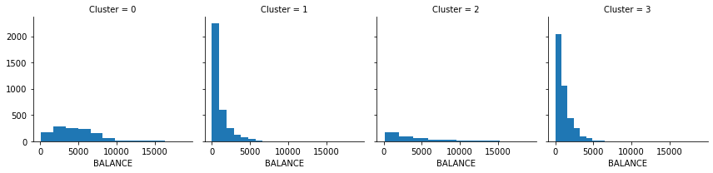
Total number of Cluster
CLUSTER_0
CLUSTER_1
CLUSTER_2
CLUSTER_3

Slide 9
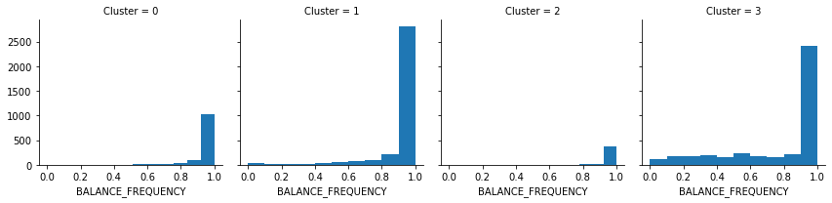
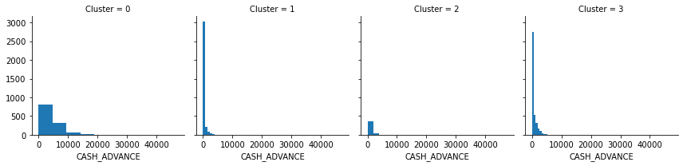

Slide 10
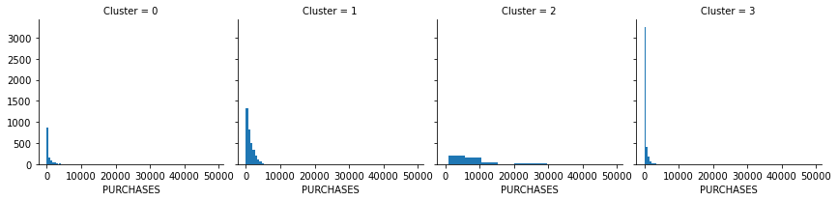
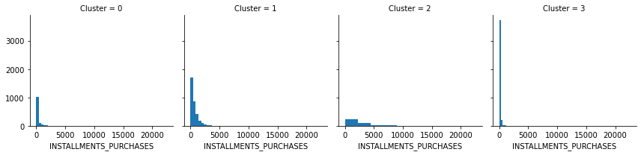

Slide 11
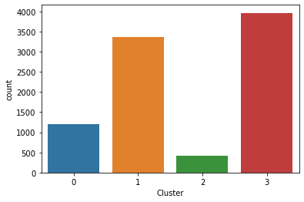
INSIGHTS GENERATED
The visuals show that the largest number of customers belongs to the cluster_1 of the sample population followed by cluster_3.
Hence concentrating more on these two group of market will be advised to bring out more productivity.

Slide 12
Deployment
There are different options to deploy ML models, such as Flask, Django, Streamlit, etc.
By collecting the required information from the customers and feeding into the created application using any of the tools mentioned above, we can identify the customer to which group he belongs to.
This helps in suggesting the customers the right plan of savings plans, loans, wealth management schemes, etc,.

Slide 13
THANK YOU
A MACHINE LEARNING BASED MARKET SEGMENTATION PROJECT

